Slide 1

Optimized Free Energies from Bidirectional Single-Molecule Force Spectroscopy
David D. L. Minh and Artur B. Adib
Physics of Complex Systems
Riccardo Tancredi
15/07/2024

Slide 2

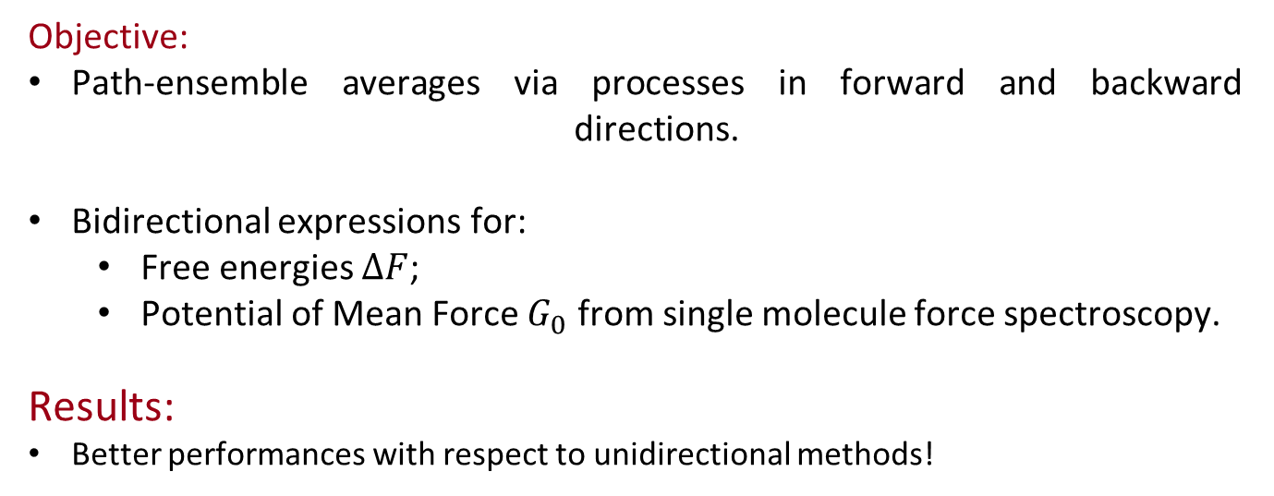
Paper Overview
Objective:
Path-ensemble averages via processes in forward and backward directions.
Bidirectional expressions for:
Free energies $ΔF$;
Potential of Mean Force $G_{0}$ from single molecule force spectroscopy.
Results:
Better performances with respect to unidirectional methods!

Slide 3

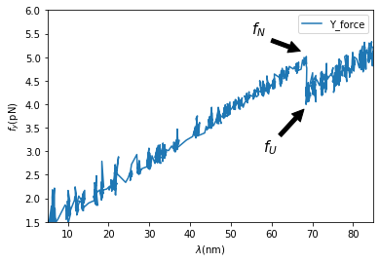
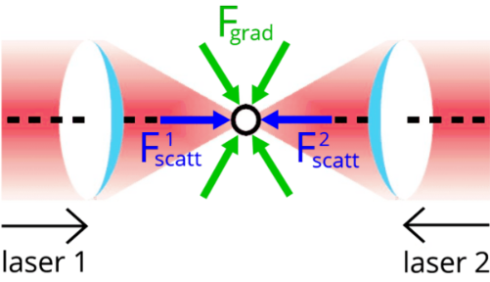
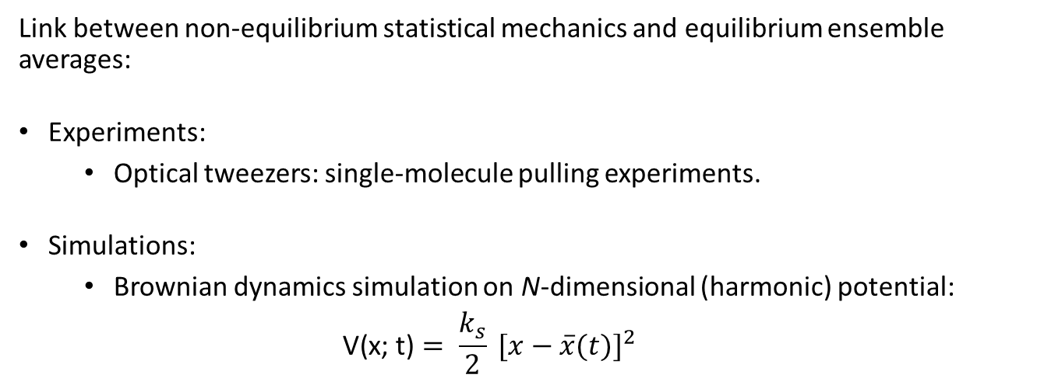
Crooks’ path-ensemble average theorem
Link between non-equilibrium statistical mechanics and equilibrium ensemble averages:
Experiments:
Optical tweezers: single-molecule pulling experiments.
Simulations:
Brownian dynamics simulation on N-dimensional (harmonic) potential:
$$\text{V}\text{(}\text{x}\text{; }\text{t}\text{)}= {\frac{k_{s}}{2} [x−\overline{x}(t)]}^{2}$$

Slide 4
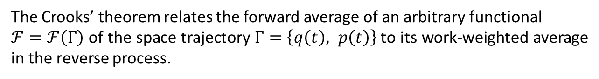
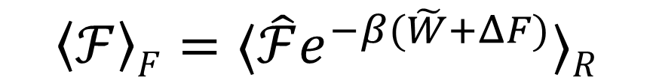
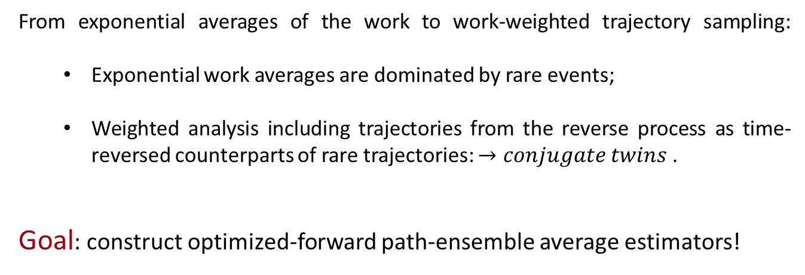
Crooks’ path-ensemble average theorem
From exponential averages of the work to work-weighted trajectory sampling:
Exponential work averages are dominated by rare events;
Weighted analysis including trajectories from the reverse process as time-reversed counterparts of rare trajectories: $→conjugate twins$ .
Goal: construct optimized-forward path-ensemble average estimators!
$$\left\langle ℱ\right\rangle F=⟨\hat{ℱ}e^{−β(\tilde{W}+ΔF)}⟩R$$
The Crooks’ theorem relates the forward average of an arbitrary functional
$ℱ=ℱ\left(Γ\right)$ of the space trajectory $Γ=\left\{q\left(t\right), p\left(t\right)\right\}$ to its work-weighted average in the reverse process.

Slide 5
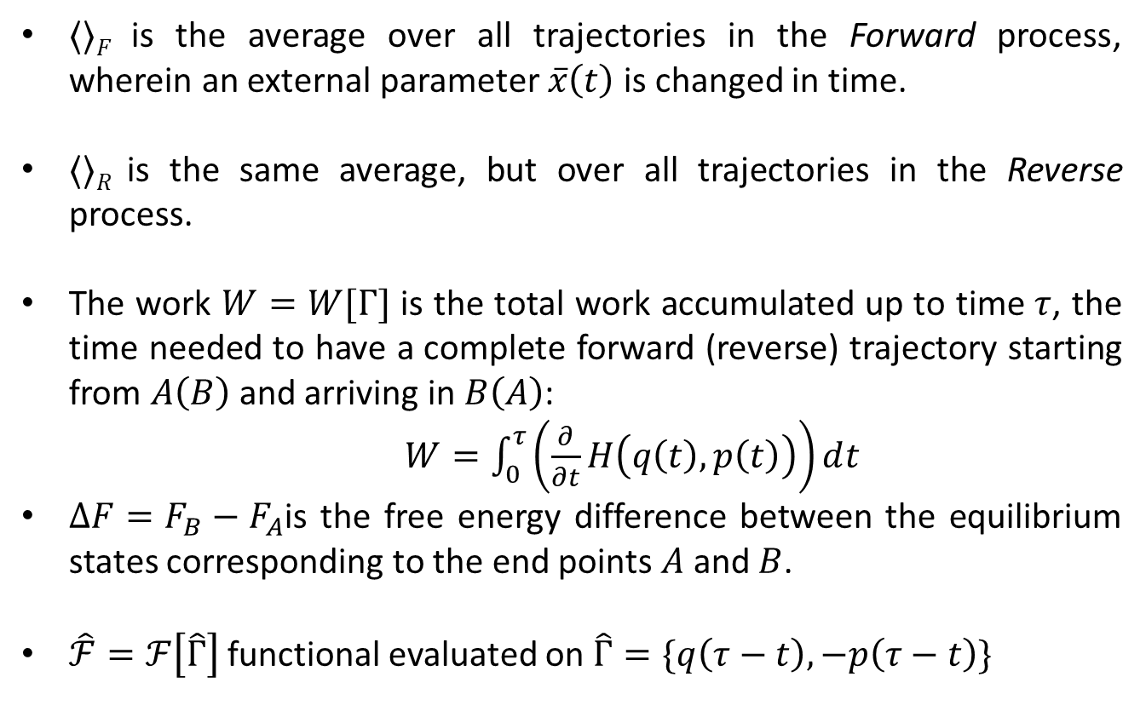
Crooks’ path-ensemble average theorem
$⟨⟩F$ is the average over all trajectories in the Forward process, wherein an external parameter $\overline{x}\left(t\right)$ is changed in time.
$⟨⟩R$ is the same average, but over all trajectories in the Reverse process.
The work $W=W[Γ]$ is the total work accumulated up to time $τ$, the time needed to have a complete forward (reverse) trajectory starting from $A\left(B\right)$ and arriving in $B\left(A\right)$:
$W=\int_{0}^{τ}{\left(\frac{∂}{∂t}H\left(q\left(t\right), p\left(t\right)\right)\right)ⅆt}$
$ΔF=F_{B}−F_{A}$is the free energy difference between the equilibrium states corresponding to the end points $A$ and $B$.
$\hat{ℱ}=ℱ\left[\hat{Γ}\right]$ functional evaluated on $\hat{Γ}=\{q\left(τ−t\right), −p\left(τ−t\right)\}$

Slide 6
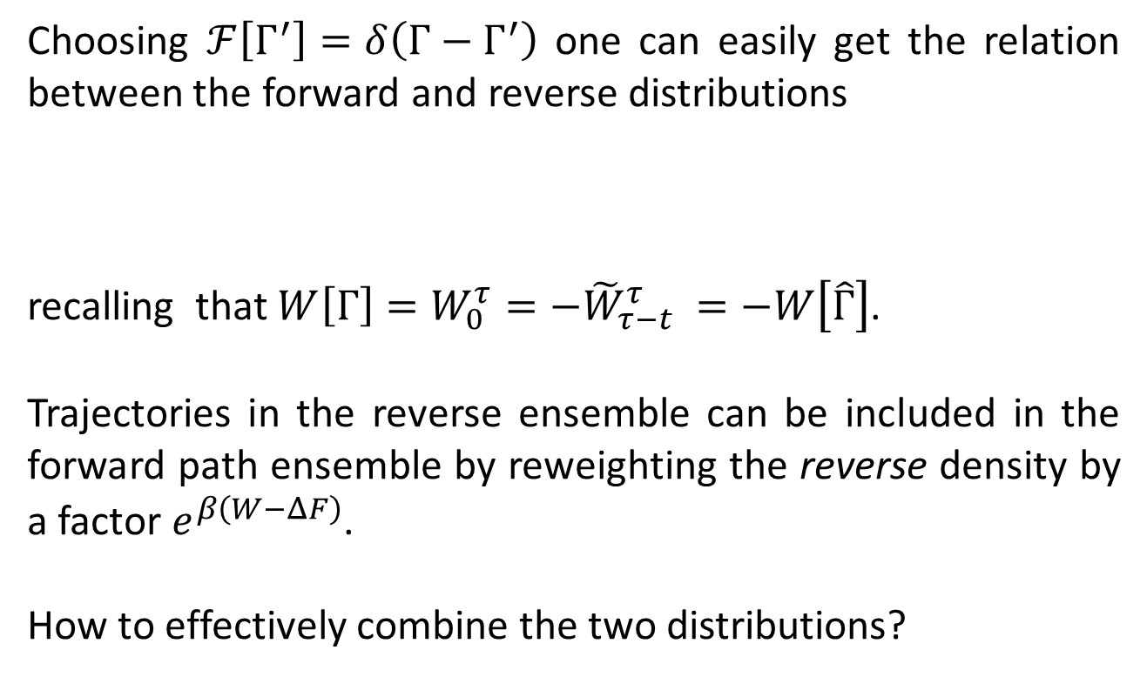
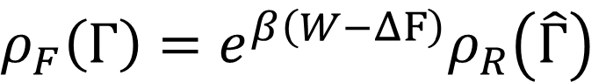
Distribution identity
Choosing $ℱ\left[Γ^{′}\right]=δ\left(Γ−Γ^{′}\right)$ one can easily get the relation between the forward and reverse distributions
recalling that $W\left[Γ\right]=W_{0}^{τ}=−{\tilde{W}}_{τ−t}^{τ} =−W\left[\hat{Γ}\right]$.
Trajectories in the reverse ensemble can be included in the forward path ensemble by reweighting the reverse density by a factor $e^{β\left(W−ΔF\right)}$.
How to effectively combine the two distributions?
$ρ_{F}\left(Γ\right)=e^{β\left(W−ΔF\right)}ρ_{R}\left(\hat{Γ}\right)$

Slide 7

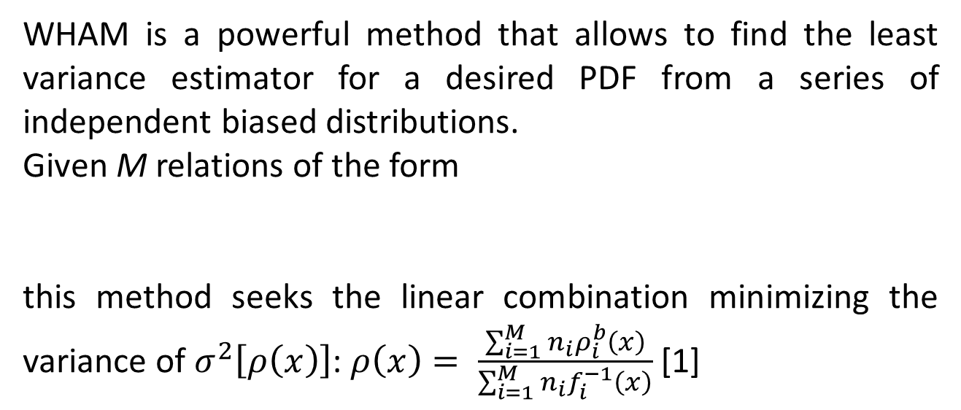
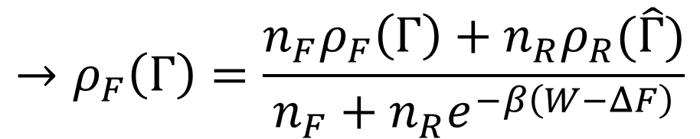
Weighted Histogram Analysis Method (WHAM)
WHAM is a powerful method that allows to find the least variance estimator for a desired PDF from a series of independent biased distributions.
Given M relations of the form
this method seeks the linear combination minimizing the variance of $σ^{2}\left[ρ\left(x\right)\right]$: $ρ\left(x\right)= \frac{\sum_{i=1}^{M}{n_{i}}ρ_{i}^{b}\left(x\right)}{\sum_{i=1}^{M}{n_{i}}f_{i}^{−1}\left(x\right)}$ [1]
$$ρ\left(x\right)=f_{i}\left(x\right)ρ_{i}^{b}\left(x\right), i∈\{1, …,M\}$$
$$→ρ_{F}\left(Γ\right)=\frac{n_{F}ρ_{F}\left(Γ\right)+n_{R}ρ_{R}(\hat{Γ})}{n_{F}+n_{R}e^{−β\left(W−ΔF\right)}}$$

Slide 8
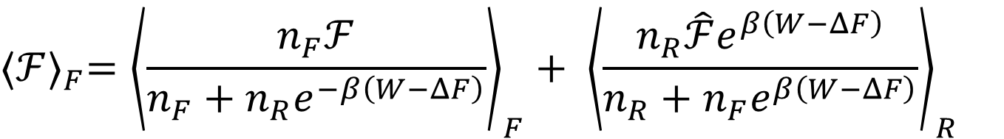
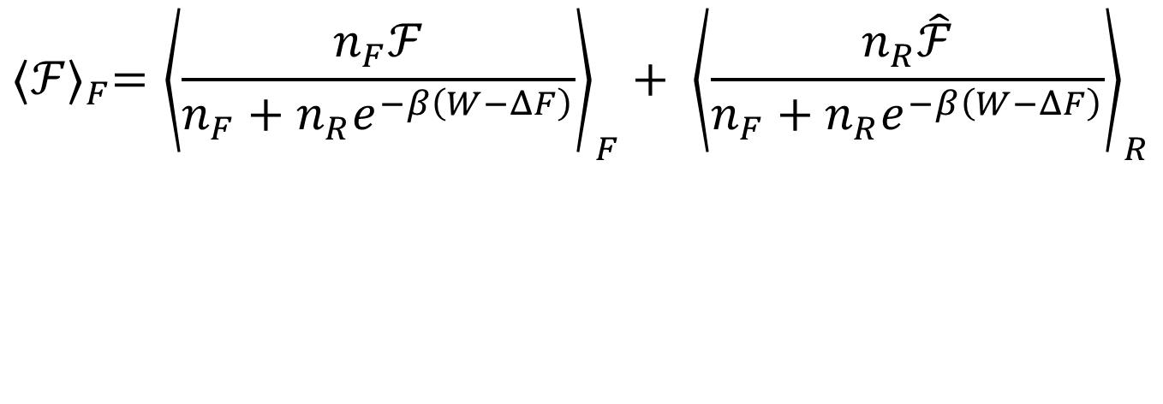

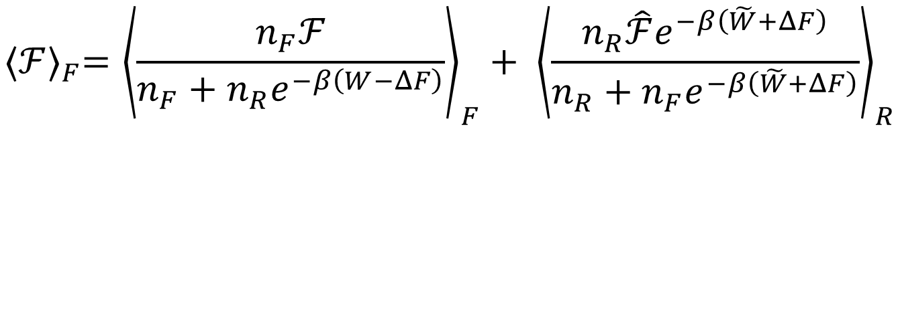
Forward path-ensemble average of $𝓕$
$${⟨ℱ⟩}_{F}={\left\langle \frac{n_{F}ℱ}{n_{F}+n_{R}e^{−β\left(W−ΔF\right)}}\right\rangle }_{F}+ {\left\langle \frac{n_{R}\hat{ℱ}}{n_{F}+n_{R}e^{−β\left(W−ΔF\right)}}\right\rangle }_{R}$$
$${⟨ℱ⟩}_{F}={\left\langle \frac{n_{F}ℱ}{n_{F}+n_{R}e^{−β\left(W−ΔF\right)}}\right\rangle }_{F}+ {\left\langle \frac{n_{R}\hat{ℱ}e^{β\left(W−ΔF\right)}}{n_{R}+n_{F}e^{β\left(W−ΔF\right)}}\right\rangle }_{R}$$
$${⟨ℱ⟩}_{F}={\left\langle \frac{n_{F}ℱ}{n_{F}+n_{R}e^{−β\left(W−ΔF\right)}}\right\rangle }_{F}+ {\left\langle \frac{n_{R}\hat{ℱ}e^{−β\left(\tilde{W}+ΔF\right)}}{n_{R}+n_{F}e^{−β\left(\tilde{W}+ΔF\right)}}\right\rangle }_{R}$$

Slide 9
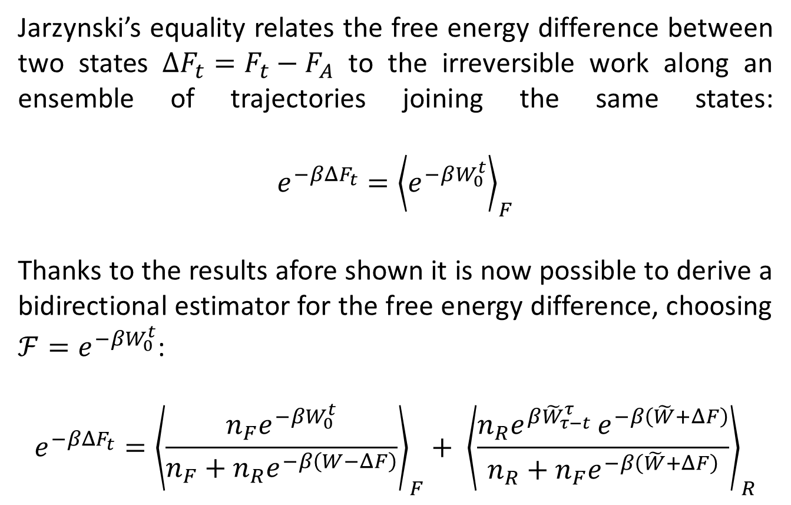
Jarzynski’s equality
Jarzynski’s equality relates the free energy difference between two states $ΔF_{t}=F_{t}−F_{A}$ to the irreversible work along an ensemble of trajectories joining the same states:
$$e^{−βΔF_{t}}={\left\langle e^{−βW_{0}^{t}}\right\rangle }_{F}$$
Thanks to the results afore shown it is now possible to derive a bidirectional estimator for the free energy difference, choosing $ℱ=e^{−βW_{0}^{t}}$:
$$e^{−βΔF_{t}}={\left\langle \frac{n_{F}e^{−βW_{0}^{t}}}{n_{F}+n_{R}e^{−β\left(W−ΔF\right)}}\right\rangle }_{F}+ {\left\langle \frac{n_{R}e^{β{\tilde{W}}_{τ−t}^{τ} }e^{−β\left(\tilde{W}+ΔF\right)}}{n_{R}+n_{F}e^{−β\left(\tilde{W}+ΔF\right)}}\right\rangle }_{R}$$
Notes:
From $\left\langle W\right\rangle ≥ΔF$

Slide 10

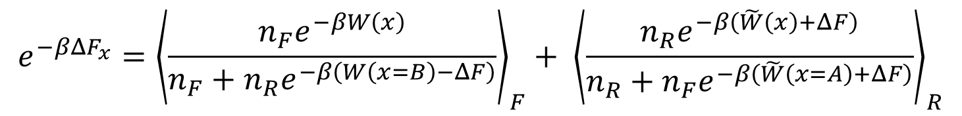
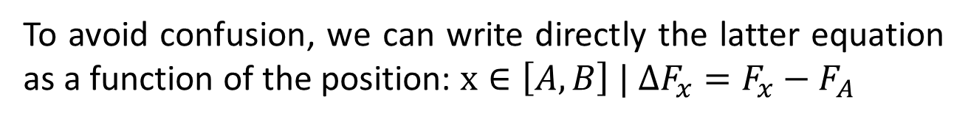
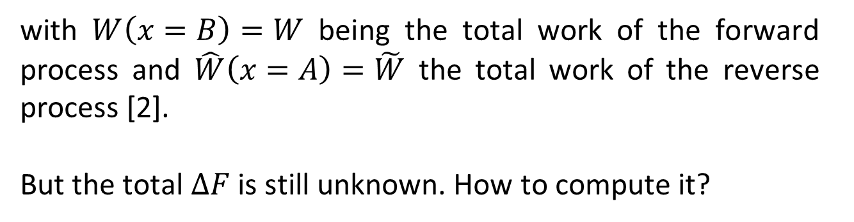
Bidirectional estimator for $ΔF_{t}$
To avoid confusion, we can write directly the latter equation as a function of the position: $x∈\left[A, B\right] | ΔF_{x}=F_{x}−F_{A}$
$$e^{−βΔF_{x}}={\left\langle \frac{n_{F}e^{−βW\left(x\right)}}{n_{F}+n_{R}e^{−β\left(W\left(x=B\right)−ΔF\right)}}\right\rangle }_{F}+ {\left\langle \frac{n_{R}e^{−β\left(\tilde{W}\left(x\right)+ΔF\right)}}{n_{R}+n_{F}e^{−β\left(\tilde{W}\left(x=A\right)+ΔF\right)}}\right\rangle }_{R}$$
with $W\left(x=B\right)=W$ being the total work of the forward process and $\hat{W}\left(x=A\right)=\tilde{W}$ the total work of the reverse process [2].
But the total $ΔF$is still unknown. How to compute it?

Slide 11

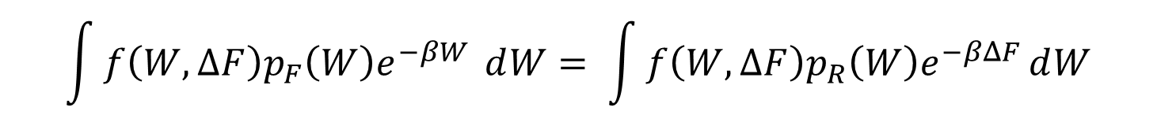
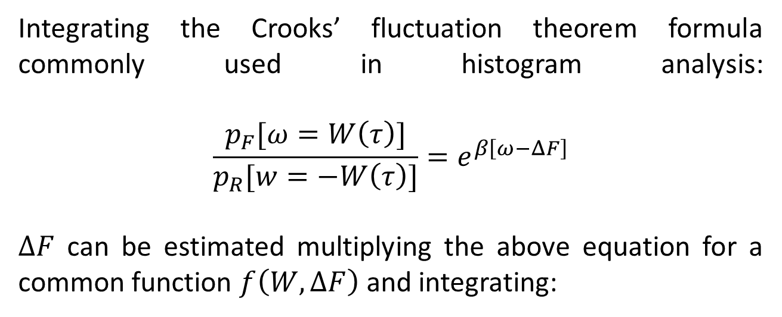
$ΔF:$ Bennett Acceptance Ratio (BAR) formula
Integrating the Crooks’ fluctuation theorem formula commonly used in histogram analysis:
$$\frac{p_{F}[ω=W\left(τ\right)]}{p_{R}[w=−W\left(τ\right)]}=e^{β\left[ω−ΔF\right]}$$
$ΔF$ can be estimated multiplying the above equation for a common function $f\left(W, ΔF\right)$ and integrating:
$$\int{f\left(W, ΔF\right)p_{F}\left(W\right)e^{−βW} ⅆW= \int{f\left(W, ΔF\right)p_{R}\left(W\right)e^{−βΔF}ⅆW}}$$
which is an implicit equation for $ΔF$.

Slide 12

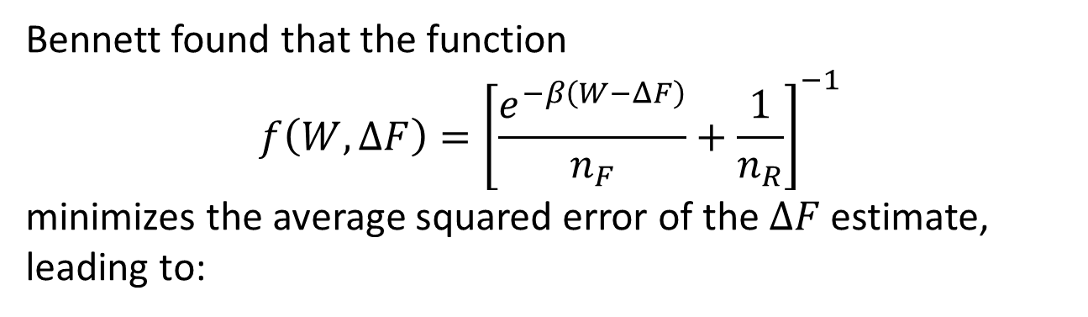
$ΔF:$ Bennett Acceptance Ratio (BAR) formula
Bennett found that the function
$$f\left(W, ΔF\right)={\left[\frac{e^{−β\left(W−ΔF\right)}}{n_{F}}+\frac{1}{n_{R}}\right]}^{−1}$$ minimizes the average squared error of the $ΔF$ estimate, leading to:
$$\sum_{i=1}^{n_{F}}{\frac{1}{1+\frac{n_{F}}{n_{R}}e^{β\left(W_{i}−ΔF\right)}}=\sum_{i=1}^{n_{R}}{\frac{1}{1+\frac{n_{R}}{n_{F}}e^{β\left({\tilde{W}}_{i}+ΔF\right)}}}}$$
which is the BAR method [3].
Notes:
Newton–Raphson solver

Slide 13
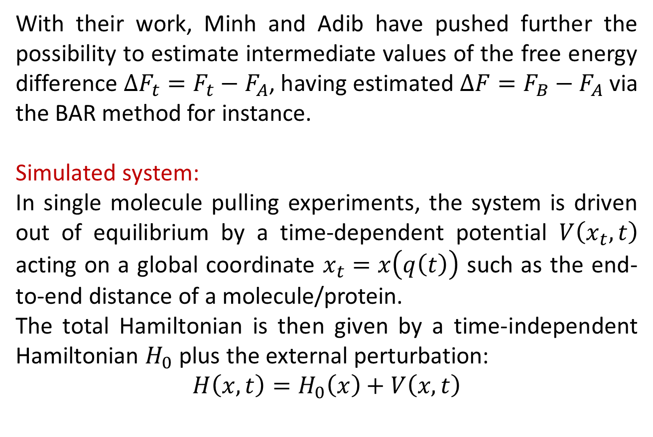
Minh and Adib main result:
With their work, Minh and Adib have pushed further the possibility to estimate intermediate values of the free energy difference $ΔF_{t}=F_{t}−F_{A}$, having estimated $ΔF=F_{B}−F_{A}$ via the BAR method for instance.
Simulated system:
In single molecule pulling experiments, the system is driven out of equilibrium by a time-dependent potential $V\left(x_{t}, t\right)$ acting on a global coordinate $x_{t}=x\left(q\left(t\right)\right)$ such as the end-to-end distance of a molecule/protein.
The total Hamiltonian is then given by a time-independent Hamiltonian $H_{0}$ plus the external perturbation:
$H\left(x, t\right)=H_{0}\left(x\right)+V\left(x, t\right)$

Slide 14
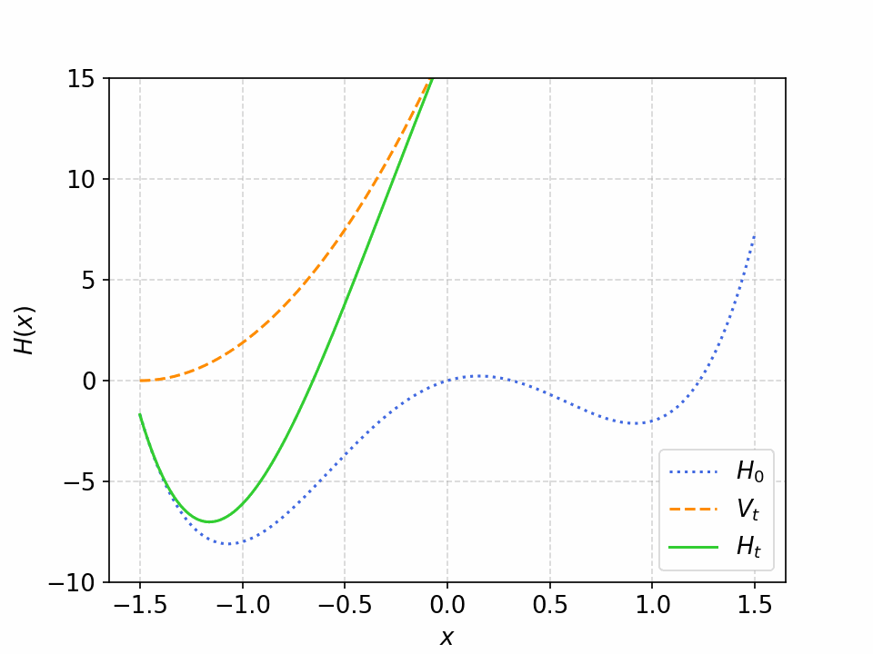
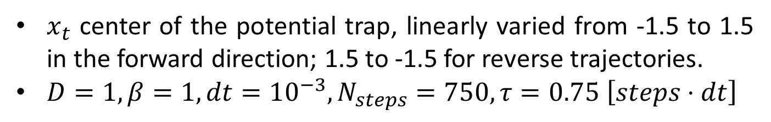
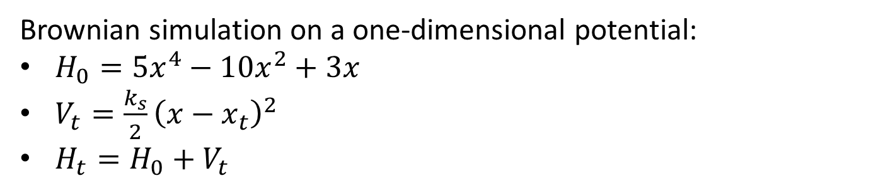
Computer simulation:
Brownian simulation on a one-dimensional potential:
$H_{0}=5x^{4}−10x^{2}+3x$
$V_{t}=\frac{k_{s}}{2}{\left(x−x_{t}\right)}^{2}$
$H_{t}=H_{0}+V_{t}$
$x_{t}$ center of the potential trap, linearly varied from -1.5 to 1.5 in the forward direction; 1.5 to -1.5 for reverse trajectories.
$D=1, β=1, dt={10}^{−3}, N_{steps}=750,τ=0.75 \left[steps⋅dt\right]$

Slide 15
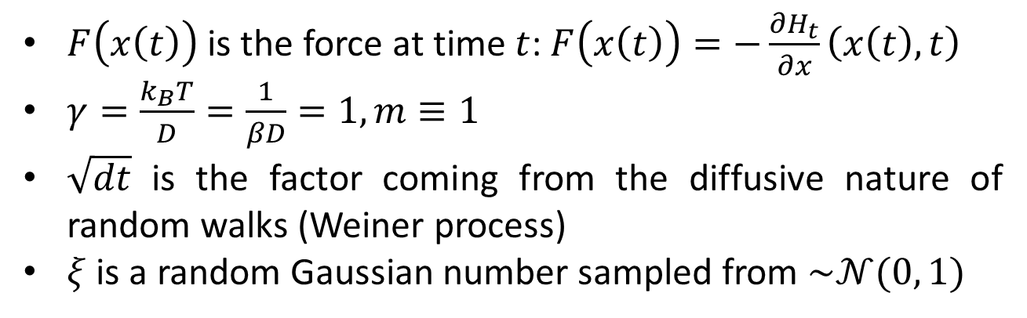
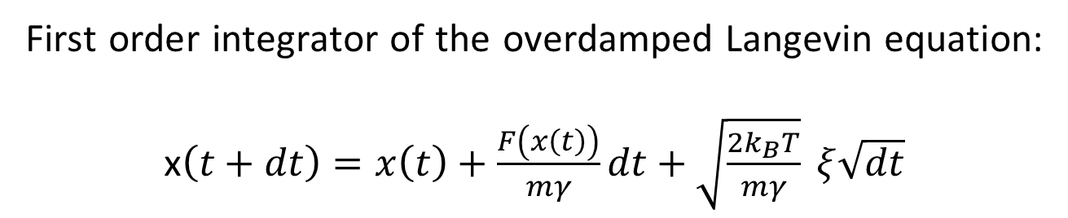
Overdamped Langevin dynamics:
First order integrator of the overdamped Langevin equation:
x$\left(t+dt\right)=x\left(t\right)+\frac{F\left(x\left(t\right)\right)}{mγ}dt+\sqrt{\frac{2k_{B}T}{mγ}} ξ\sqrt{dt}$
$F\left(x\left(t\right)\right)$ is the force at time $t$: $F\left(x\left(t\right)\right)=−\frac{∂H_{t}}{∂x}\left(x\left(t\right), t\right)$
$γ=\frac{k_{B}T}{D}=\frac{1}{βD}=1, m≡1$
$\sqrt{dt}$ is the factor coming from the diffusive nature of random walks (Weiner process)
$ξ$ is a random Gaussian number sampled from $\sim 𝒩(0, 1)$

Slide 16
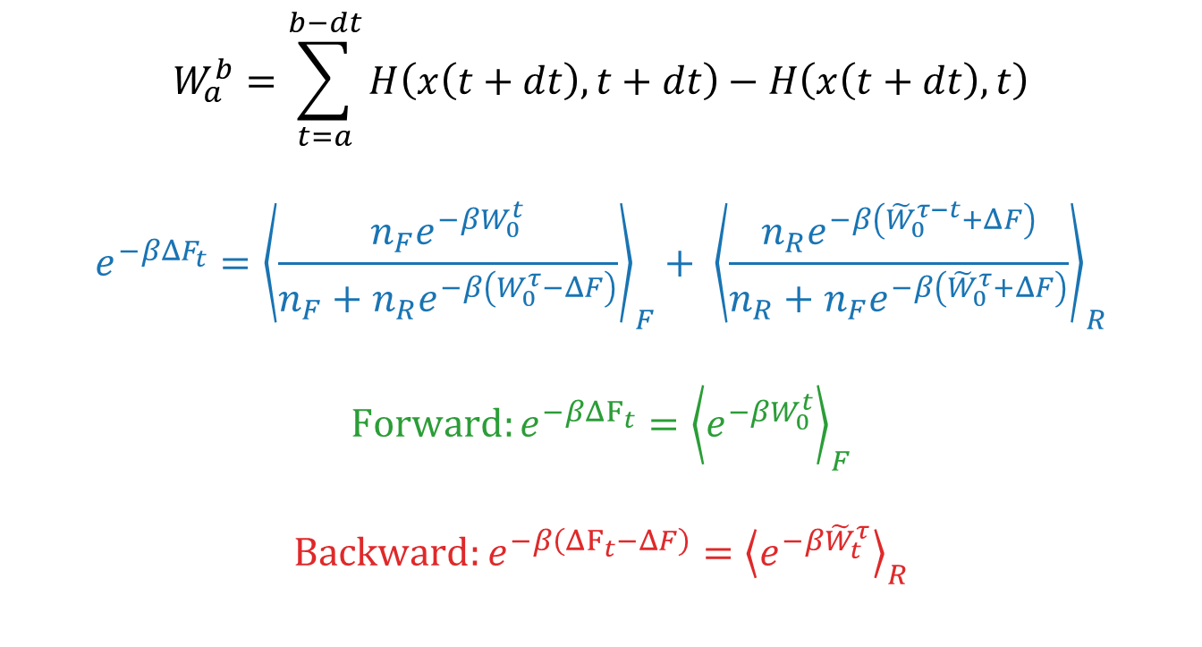
Work computation:
$$W_{a}^{b}=\sum_{t=a}^{b−dt}{H\left(x\left(t+dt\right), t+dt\right)−H\left(x\left(t+dt\right), t\right)}$$
$$e^{−βΔF_{t}}={\left\langle \frac{n_{F}e^{−βW_{0}^{t}}}{n_{F}+n_{R}e^{−β\left(W_{0}^{τ}−ΔF\right)}}\right\rangle }_{F}+ {\left\langle \frac{n_{R}e^{−β\left({\tilde{W}}_{0}^{τ−t}+ΔF\right)}}{n_{R}+n_{F}e^{−β\left({\tilde{W}}_{0}^{τ}+ΔF\right)}}\right\rangle }_{R}$$
$$Forward:e^{−βΔF_{t}}={\left\langle e^{−βW_{0}^{t}}\right\rangle }_{F}$$
$$Backward:e^{−β\left(ΔF_{t}−ΔF\right)}={\left\langle e^{−β{\tilde{W}}_{t}^{τ}}\right\rangle }_{R}$$

Slide 17
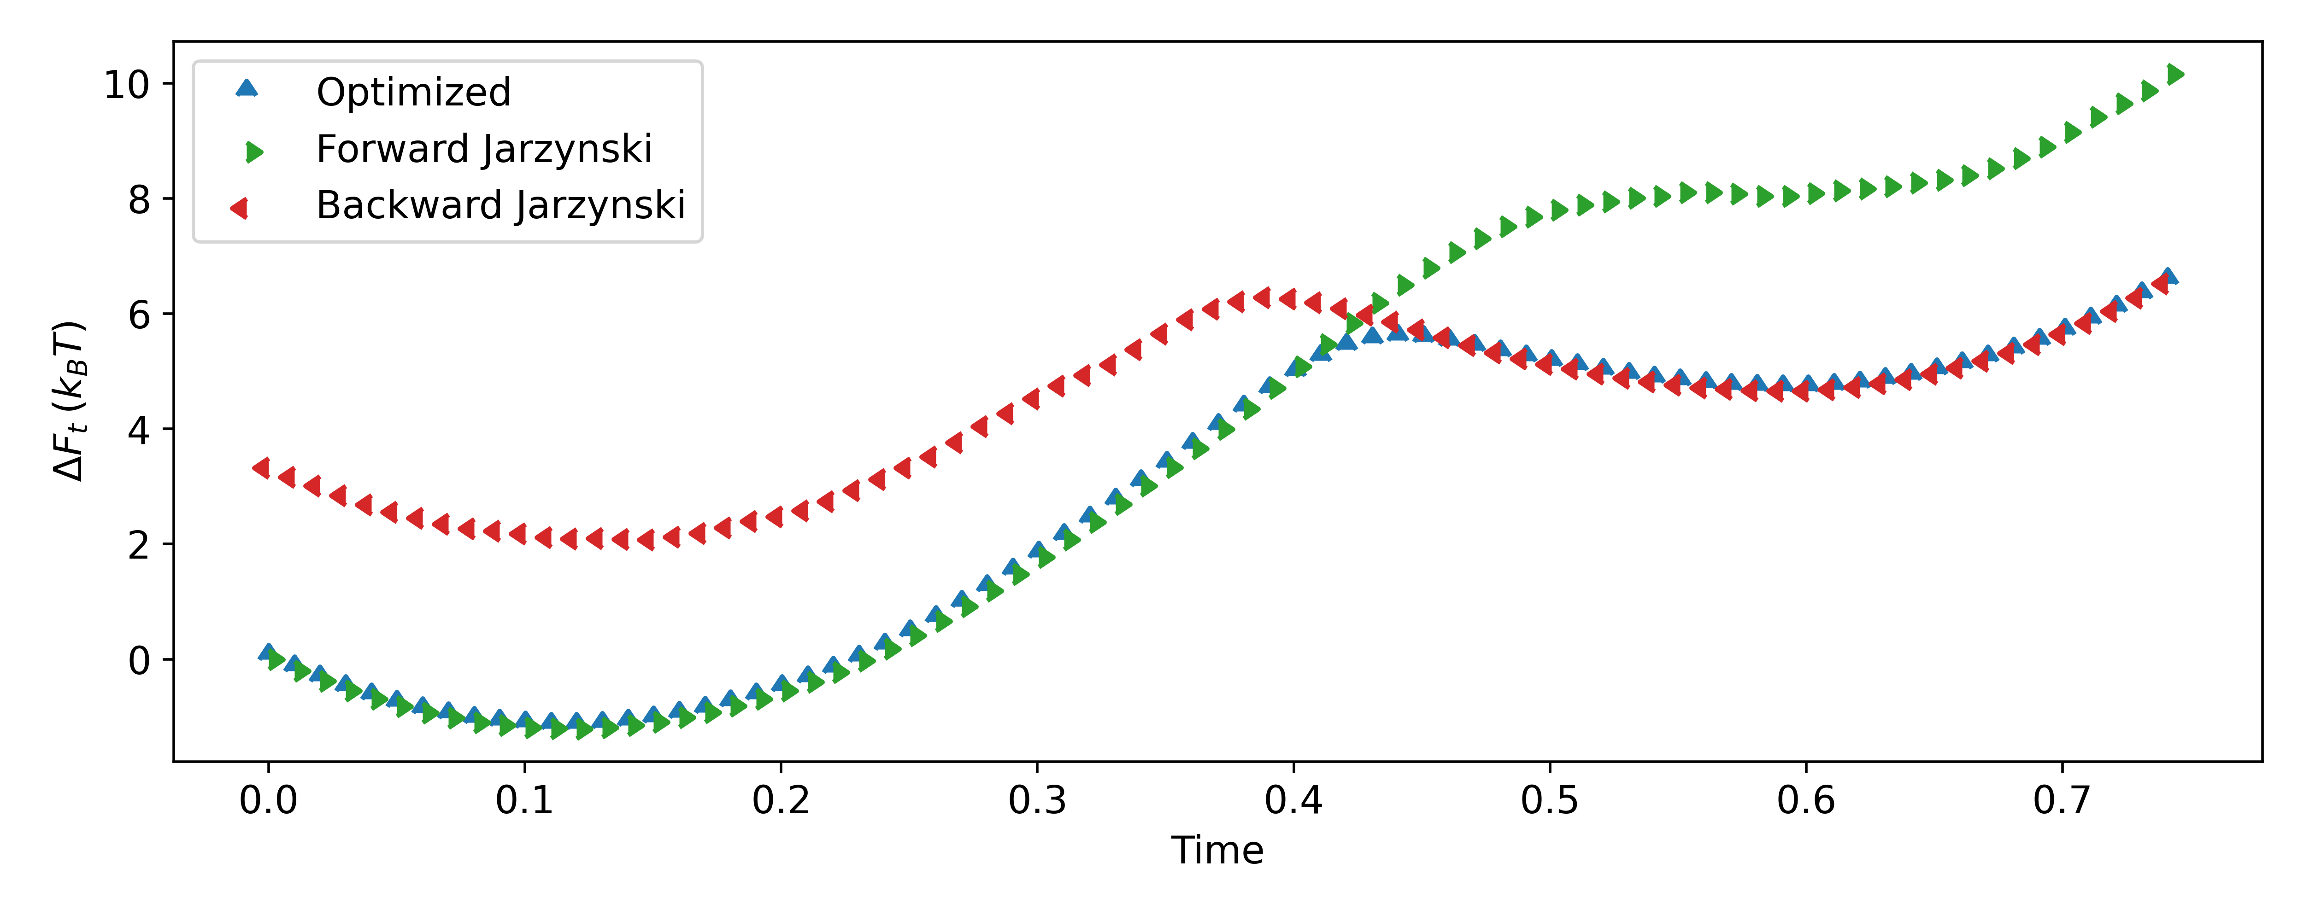
Results comparison:

Slide 18
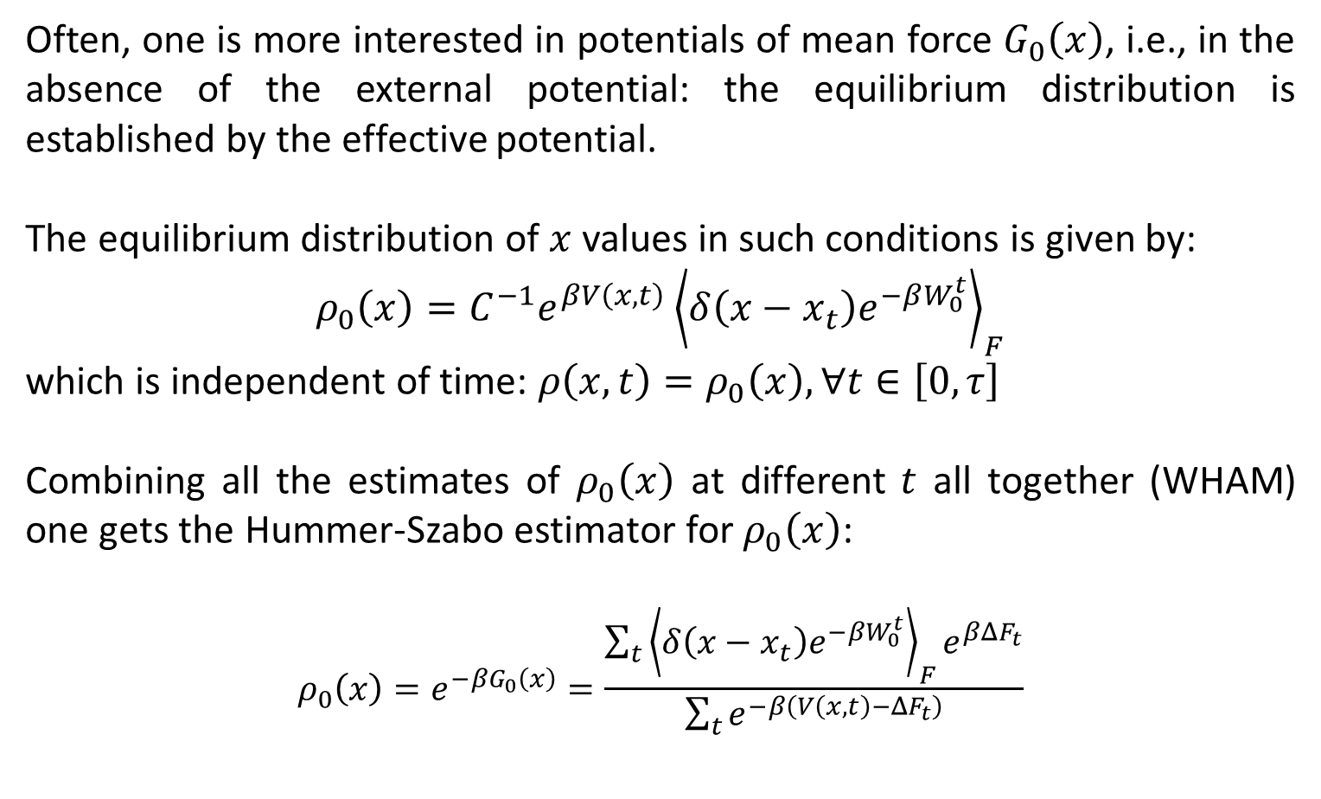
Potential of Mean Force (PMF)
Often, one is more interested in potentials of mean force $G_{0}\left(x\right)$, i.e., in the absence of the external potential: the equilibrium distribution is established by the effective potential.
The equilibrium distribution of $x$ values in such conditions is given by:
$$ρ_{0}\left(x\right)=C^{−1}e^{βV\left(x,t\right)}{\left\langle δ\left(x−x_{t}\right)e^{−βW_{0}^{t}}\right\rangle }_{F}$$
which is independent of time: $ρ\left(x,t\right)=ρ_{0}\left(x\right), ∀t∈\left[0, τ\right]$
Combining all the estimates of $ρ_{0}\left(x\right)$ at different $t$ all together (WHAM) one gets the Hummer-Szabo estimator for $ρ_{0}\left(x\right)$:
$$ρ_{0}\left(x\right)=e^{−βG_{0}\left(x\right)}=\frac{\sum_{t}{{\left\langle δ\left(x−x_{t}\right)e^{−βW_{0}^{t}}\right\rangle }_{F}e^{βΔF_{t}}}}{\sum_{t}{e^{−β\left(V\left(x, t\right)−ΔF_{t}\right)}}}$$
Notes:
The estimate for $\tilde{ρ_{0}(z)}$ for the backward process is estimated in the very same manner, but $W_{0}^{t}→{\tilde{W}}_{0}^{t}$ and $ΔF→\tilde{ΔF_{t}}=ΔF_{t}−ΔF$ (the one directly estimated via the Jarzynski equality in the reverse direction). Then, of course, within this procedure, the time arrow is flipped such that $x_{t}∈\left[A, …, B\right]$, since $\tilde{x_{t}}∈\left[B, …, A\right]$

Slide 19

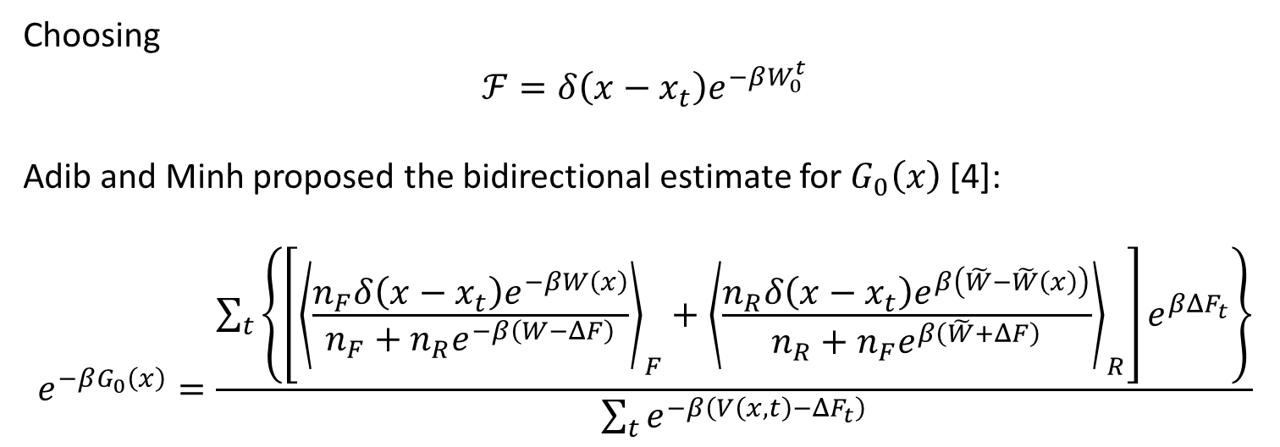
Bidirectional PMF estimator for $G_{0}\left(z\right):$
Choosing
$ℱ=δ\left(x−x_{t}\right)e^{−βW_{0}^{t}}$
Adib and Minh proposed the bidirectional estimate for $G_{0}\left(x\right)$ [4]:
$$e^{−βG_{0}\left(x\right)}=\frac{\sum_{t}{\left\{\left[{\left\langle \frac{n_{F}δ\left(x−x_{t}\right)e^{−βW\left(x\right)}}{n_{F}+n_{R}e^{−β\left(W−ΔF\right)}}\right\rangle }_{F}+{\left\langle \frac{n_{R}δ\left(x−x_{t}\right)e^{β\left(\tilde{W}−\tilde{W}\left(x\right)\right)}}{n_{R}+n_{F}e^{β\left(\tilde{W}+ΔF\right)}}\right\rangle }_{R}\right]e^{βΔF_{t}}\right\}}}{\sum_{t}{e^{−β\left(V\left(x, t\right)−ΔF_{t}\right)}}}$$
\

Slide 20
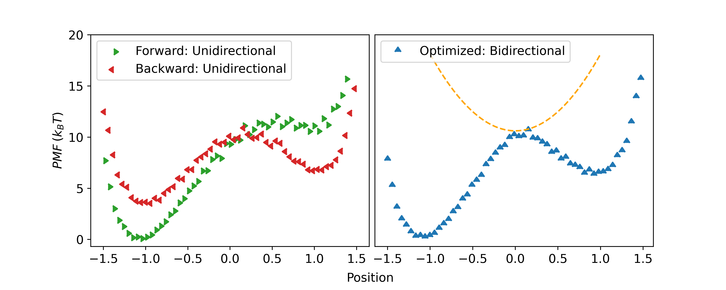
Results comparison:

Slide 21
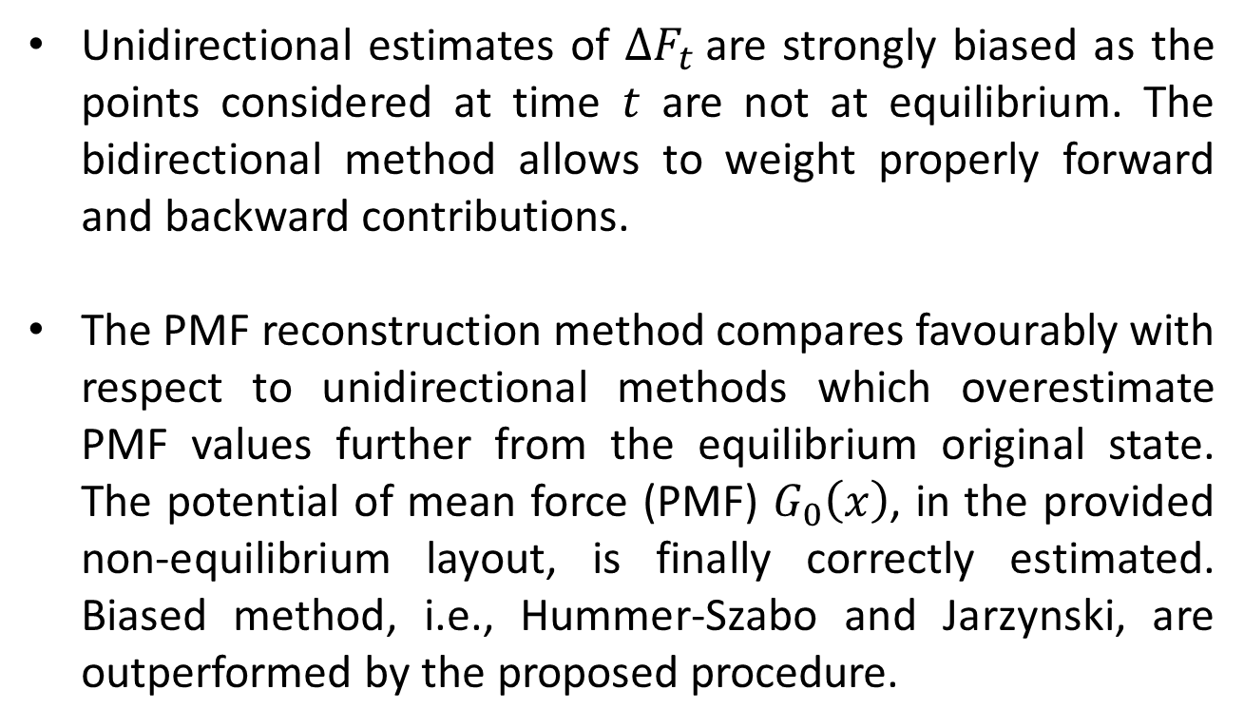
Conclusions
Unidirectional estimates of $ΔF_{t}$are strongly biased as the points considered at time $t$ are not at equilibrium. The bidirectional method allows to weight properly forward and backward contributions.
The PMF reconstruction method compares favourably with respect to unidirectional methods which overestimate PMF values further from the equilibrium original state. The potential of mean force (PMF) $G_{0}\left(x\right)$, in the provided non-equilibrium layout, is finally correctly estimated. Biased method, i.e., Hummer-Szabo and Jarzynski, are outperformed by the proposed procedure.

Slide 22
Thank you for your attention!

Slide 23

Bibliography
Minh, David DL, and Artur B. Adib. "Optimized free energies from bidirectional single-molecule force spectroscopy." Physical review letters 100.18 (2008): 180602.
Hummer, Gerhard, and Attila Szabo. "Free energy profiles from single-molecule pulling experiments." Proceedings of the National Academy of Sciences 107.50 (2010): 21441-21446.
Chipot, Christophe, and Andrew Pohorille. Free energy calculations. Vol. 86. Berlin: Springer, 2007 – pag. 203-209.
Nicolini, Paolo, Piero Procacci, and Riccardo Chelli. "Hummer and Szabo-like potential of mean force estimator for bidirectional nonequilibrium pulling experiments/simulations." The Journal of Physical Chemistry B 114.29 (2010): 9546-9554.
All the shown material and the used code is available on my page

